Slide 1

9th Global Islamic Microfinance Forum, 11 December 2019 @ Lahore
Microfinance-Success & Challenges of Sindh
By: Aijaz Ali Khuwaja

Slide 2
Poverty Eradication Initiative (PEI)- Introduction
PEI established in 2002, is a non-profit organization, striving to alleviate poverty and bring about a positive change in lives of the poorest of the poor.
PEI is working with Govt of Sindh under Public Private Partnership interventions
First time PEI introduced a model of Entrepreneurship in Health sector
PEI established 174 Community led birthing stations under self entrepreneurship model and linked CMWs with Microfinance lending institutions like RSPs, banks and mobile banking services

Slide 3
Microfinance Initiatives
Microcredit was once hailed as "the solution for global poverty." (1) At the turn of the millennium, the world was full of hope for the latest tool in fighting poverty.
The chair of the United Nations Committee on Poverty Statistics, Jonathan Morduch, declared: "The hope is that much poverty can be eliminated – and that economic and social structures can be transformed fundamentally – by providing financial services to low-income households.
During the first decade of the millennium, microcredit gained the attention of most international development organizations and the United Nations and World Bank devoted extensive resources to promoting it.
Governments invested in microfinance agencies and large private microfinance institutions developed.

Slide 4
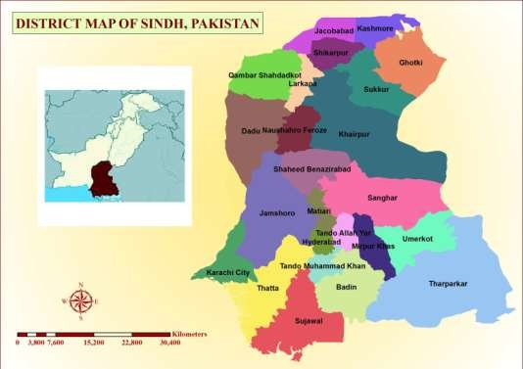
About Sindh & Microfinance Interventions

Slide 5
About Sindh & Microfinance Initiatives
Sindh is province of Pakistan. Current population of Pakistan (208 million) & population of Sindh is 47.8 million (Census 2017)
Sindh is the 2nd largest province of Pakistan
Different microfinance banks, Rural Support Programs, Mobile banking services have started operations from 2000 onward
Islamic banking operations started from 2010
Total 843 Islamic Banking branches are working in 21 districts Sindh (SBP June, 2019)
These all branches exist in urban (Karachi 679, Hyderabad 56, Sukkur 18, Nawabshah 16, Mirpurkhas 11, Sanghar 14, Badin 3, Dadu 6, Gotki 3, Jackobabad 5, Jamshoro 3, Khairpur 3, Larkana 6, Matiari 3, Nausheroferoz 3, Shikarpur 1, Shehdadkot 2, Tando Allahyar 4, Tando Mohd Khan 1, Thatta 2, Umerkot 4.
No Islamic banking system exist in district Sujawal, Tharparkar, Jamshoro, Qambar Shehdadkot & Kashmore.

Slide 6
RSPs-Village Organization Banking & Community Investment Fund
Village Organization Banking system was first introduced by AKRSP in Pakistan
VO Banking System was based on Land Development, Agriculture Development, Credit & Banking & Marketing
After success of VO Banking system, Rural Micro-financing was started all over rural areas in Pakistan through different initiatives
Banking sector is now actively providing microfinance to semi urban and urban areas

Slide 7
Branch Network of IBI
The network of Islamic banking industry
consisted of 22 Islamic banking institutions; 5
full-fledged Islamic banks (IBs) and 17
conventional banks having standalone Islamic
banking branches (IBBs) by end June, 2019.
Branch network of Islamic banking industry
was recorded at 2,913 (spread across 113
districts) by end June, 2019.
More than 77 percent of the branches were concentrated in Punjab and Sindh.
The number of Islamic banking windows operated by conventional banks having standalone Islamic banking
branches stood at 1,348
Source: State Bank Report, June 2019

Slide 8
Microfinance-Review
Review of client wise financing reveals that
corporate sector accounted for 73.5 percent
share in overall financing of Islamic banking
industry, followed by commodity financing
with a share of 10.6 percent and consumer
financing 10.4 percent.
The share of small and medium enterprises (SMEs) financing and agriculture financing in overall financing of Islamic banking industry were recorded at 3.7 percent and 0.5 percent, respectively
Source: State Bank Report June 2019

Slide 9
Participatory Mode
Pakistan’s private sector players focus on participatory modes of Islamic finance instruments to
enhance risk-sharing practice\
The private sector has taken upon itself to conduct research in developing and promoting more
participatory modes of Shariah compliant financial instruments.
Under the ambit of a newly formed strategic partnership, the Islamic banking arm of Bank Alfalah and the Centre for Islamic Finance (CIF) at the Lahore University of Management Sciences (LUMS) will spearhead a research initiative to promote the Republic’s first asset-side Musharakah-based financing product, according to Pakistan
Source: Press International.
www.islamicfinancenews.com

Slide 10
Microfinance-Future of banking
Younger customers are expected to play a crucial role in the growth of Islamic finance and expand its
customer base in the future.
With Muslim spend estimated at $2.1 trillion in 2017, the Islamic
economy continues its steady growth driven by an expanding, young Muslim population, which is expected to reach 3 billion in 2060, up from 1.8 billion in 2017, State of the Global Islamic Economy
Report 2018-19 shows that ,“Islamic banking continues to outpace growth in conventional banking as Muslims and non-Muslims alike – seek more ethical ways to bank and finance projects,”.
Pakistan have 60% plus younger generation which can get benefit of all Islamic banking initiatives.
https://gulfnews.com/business/banking/millennials-key-to-the-future-of-islamic-banking-
1.1561626464714
Source: Gulf News, Dubai

Slide 11
Microfinance & SDGs
Moving Islamic banking beyond the CSR paradigm
Financing the SDG agenda internationally requires trillions of dollars.
The governments investments are not enough to provide the needed financial resources. Thereby, the private sector in general and the financial sector in particular are required to bridge the financing gap and support the SDGs.
In Sindh, Gas & Oil exploring companies, Sugar and other Industries can support banking sector to finance microfinance initiatives in poorest of the poor semi urban, rural and remote rural areas.
Pakistan missed most of MDG targets (2000-2010) related to poverty. Now strongly needed support of all relevant sectors to address poverty through microfinance to reach the poor and attend International goals/targets.

Slide 12
Microfinance & Climate Change Initiatives
Sustainability risk: should Islamic finance learn from the ESG, SRI and green products?
During the last years, in Europe and even globally, investment trends highlighted that more and more investors who were interested in investing in innovative and real economy-linked products shifted their preferences from classical Islamic finance/faith-based products to more tailor-made types of
sustainable investments (such as environmental, social and governance (ESG), sustainable and responsible investment (SRI) and green).
In essence, Islamic finance is by definition a heterogeneous compilation of ESG, SRI, green and donation-based investments and more with
positive impacts on individuals, society and environment.
It would be interesting to understand how Islamic Banking can workout new models/strategies while keeping in mind all changing factors
This shift could be analyzed and explained from pure operational aspects

Slide 13
Islamic Social Finance
In 2015, countries around the world adopted a set of goals to end poverty, protect the planet, and ensure prosperity for all as part of a new sustainable development agenda. Formulated on the principle that no one is left behind, the Sustainable Development Goals (SDGs) have defined the world’s priorities and aspirations for 2030.
To mobilize these efforts, we need to effectively uplift groups at the bottom where poverty plays a main obstacle
Although poverty levels have fallen dramatically
since 2000, there are still 783 million people living below the international poverty line
In Sindh around 36% people are living below the poverty line, as per Govt figures (Donors figures varied)
Islamic Social Finance can support poorest of the poor through different initiatives in Sindh.

Slide 14
Rural Micro-financing in Sindh
Rural micro-financing is still at nascent age in rural setup of Sindh, Pakistan.
The involvement of Banking sector in rural micro-financing is yet to establish.
The First Micro-Finance Bank, Tameer Bank, Khushali Bank, NRSP Bank, Telenore, Uphone banking, TRDP, SAFWCO & other microfinance banking sector is now gradually establishing their local branches in Sindh, Pakistan.
Rural Microfinancing is only catering needs of 10% to 12% of rural communities in Sindh Pakistan.

Slide 15
Rural Micro-financing-Sindh
The most important feature of Community Based Micro-finance initiative is that community is itself monitoring their own development and reporting to organisation on regular basis.
Mostly female CSOs have identified female members for lending of micro-finance. They are giving their own guarantee for return of money on regular basis.
The access of poorest of the poor female community to microfinancing is only 3% . Still around 97% rural female community in Sindh have no access to microfinance.

Slide 16
Micro-finance Nexus with Technical Skills
Microfinance in Pakistan is still at nascent age and only 12% to 15% community in rural and semi urban setup is getting benefit.
Financial Institutions are working in isolation in rural areas of Sindh, Pakistan.
Public/Private Financial Institutions are giving less or no priority to rural downtrodden communities due to their chronic poverty and vulnerability. Rural masses have no proper access to regular banking system.
RSPs are giving priority but they have not sufficient funding to reach all poor areas in all districts of Sindh, Pakistan.
Microfinance can further get success through investment in different initiatives like technical skills
Microfinance lending institutions can support communities through supplement funding for improvement of technical skills.

Slide 17
Micro-finance-Technical Skills Challenges
Microfinance institutions have emerged as a popular and credible instrument of poverty alleviation
Technical skills ,organizational and communication abilities provide better results for MFIs performance. .
It is important that banks understand that consumer protection and financial literacy are part of the investment, not an expense. Skills are must for the success of microfinance.
Aspirations of the Poor are growing, and as a result, they require loan and savings products to invest in education, healthcare and other safety nets.
Investment in technical skills will sustain microfinance investments in Sindh

Slide 18
Micro-finance-Technical Skills Challenges
The microfinance sector serves as a model and, in many ways, has created the foundation for future financial inclusion regulations. These regulations needs to be redesign as per the needs of current interventions & changes in free world markets.
There must be a paradigm shift – even though demand exists, financial institutions have fallen behind in innovating products to meet demand.
Sharing knowledge and experience is important. There must be communication among all the institutions involved, and out ‐ sourcing should be encouraged when a particular institution cannot provide a needed product.

Slide 19
Micro-Finance-TVET Skills Challenges
Strengthening the role of government, in terms of policy guidance and incentives, would accelerate the building of social credit schemes and innovation in financial inclusion.
Making micro-finance more Islamic & demand driven as per market rules & regulations.
Lower administrative/financial cost & work on roll over basis micro-finance initiatives.
Ensure Microfinance investment in TVET sector for sustainability of initiatives
Introduction of Islamic Micro-finance public and private Banking sector in rural areas of Sindh, Pakistan

Slide 20
Microfinance-Challenges
Islamic Micro-financing is a new paradigm for rural masses in Sindh, Pakistan.
Private & Public extensive Banking advocacy is required to achieve Islamic ways of micro-financing.
Not for Profit Organisations are now using term of “Financial Rolling” in micro-finance sector, which is a positive indicator towards “No profit No loss’’ philosophy.
Young population of Sindh living in rural, remote rural and semi urban areas, as well as in Katchi abadis of urban areas strongly need microfinancing schemes to address poverty and unemployment

Slide 21
Opportunities & Challenges
A joint venture of Public/Private & Not for Profit Organisations in Islamic Micro-financing is required.
Strong Community Mobilisation is required for each and every micro-finance initiatives in rural setup.
Introduction of new microfinance initiative in TVET sector is a MUST
Microfinance in Health, Education, Agriculture & Livestock sector will reduce poverty of downtrodden masses
Social Mobilisation of Client is key of Microfinance Institutions & Banking Sector is relying on financial rules & regulations, so joint venture of social mobilisation and relaxed financial rules will support to rural masses.

Slide 22
Opportunities & Challenges
Agricultural microfinance must take into consideration the special circumstances affecting agribusiness, such as seasonal fluctuations in production, changes in food prices and problems specific to a given rural area.
There is need of skills enhancement in sectors like Agriculture, food chain system & small business.
How to close the gap between specialized demand and products supplied? More Knowledge sharing, as well as additional innovation, are needed blending approaches across business model archetypes.
Effective financial service for small agribusiness requires specialized workable products, as well as client and risk assessment techniques that take into account the variegations of farming.

Slide 23
Opportunities & Challenges
Banks with Islamic micro-finance portfolio should take full advantage of their vast urban and semi urban network in order to reach the largest number of clients.
Microfinance for sustainability & poverty eradication through skills enhancement….This can be a new paradigm shift??
It may be useful to create a platform for the exchange of financial inclusion experiences, so as to diminish inconsistencies among financial inclusion best practices in different countries.
Strengthening the role of government, in terms of policy guidance and incentives, would accelerate the building of social credit schemes and innovation in financial inclusion.

Slide 24
Opportunities & Challenges
Governments and donors that aim to extend the outreach of financial services, particularly to remote and poor areas targeting the poorest women, should invest in the role out of CIF across the organized communities in Pakistan.
Community Investment Fund (CIF) can ensure sustainability of all micro-financial initiatives to get poor out of poverty and to achieve UN declared SDGs.
Enhancement of skills can sustain poverty eradication initiatives
Investment in CIF is a new opportunity to support communities, especially female out of poverty

Slide 25
Microfinance-Challenges ahead, SINDH!!!
Most Microcredit loans are used to fund consumption as well as development. Studies have shown that many beneficiaries use their loans to cover short term emergencies rather than address long-term economic growth.
The result is that microfinance may have minimal impact on income growth.
Many who receive loans lack ability to repay the loans and don't develop an incentive to generate their own sustainable source of funding.
Most loans are expensive and rely on high interest rates to meet operation costs.
Most loans promote economic inefficiency
Microlfinance enable the creation of new businesses, but the new businesses replace existing ones. Competition and lack of consumer demand in poor communities drive business failure and the majority of new businesses fail within a short time. (9)
Charity’s impact on microfinance??

Slide 26
Future ahead…….
Today, the development world has distanced itself from even using the terms "microcredit" and "microfinance." Now the focus is on reaching universal "financial inclusion."
All microfinance institutions must focus on the extreme poor through Financial Inclusion.
Over time, programs have matured and grown, but ultimately time and time again we come back to the timeless wisdom of a commoner.
lets help people discover and use the talents and resources they have to invest in something bigger than themselves.

Slide 27
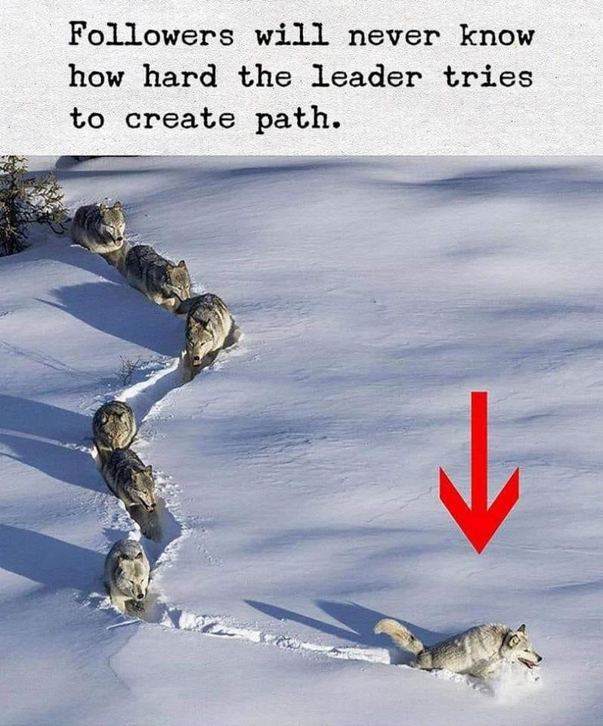
Thanks for patience

